Slide 1


Green Computing
Demonstrate knowledge of Green Computing in schools and industry
Write a report on an online research on the practice and standard of a company/industry that exhibits awareness in green computing connecting the environment and technology.

Slide 2



What Is Green Computing?
The study and practice of designing, manufacturing, using, and disposing of computers, servers, and associated subsystems efficiently and effectively with minimal or no impact on the environment.
The environmentally responsible and eco-friendly use of computers and their resources.
Also known as the “Green IT”
Green Technology

Slide 3



Why Green Computing?
Growing public environmental awareness
Increasing impacts on environmental and human health
Corporate social responsibility
Other Reasons:
Climate Change
Savings(Reduce Cost)
Reliability of Power Energy Efficient

Slide 4




Why Green Computing required?
Toxicity
Reduce pollution
Printing often unnecessary stuff is waste
Computer consumes a lot of energy

Slide 5

Why Green Computing?
One of the first manifestations of the green computing movement was the launch of the Energy Star program way back in 1992
Energy Star served as a kind of voluntary label awarded to computing products that succeeded in minimizing use of energy while maximizing efficiency.
One of the first results of green computing was the Sleep mode function of computer monitors which places a consumer's electronic equipment on standby mode when a pre-set period of time passes when user activity is not detected.
http://kamipunyaassignment.blogspot.com/2011/11/history-of-green-computing.html

Slide 6



Why Go Green?
Climate Change
CO2 and other emissions are causing global climate and environmental damage
Reliability of power
As energy demands in the world go up, energy supply is declining or flat.
Computing
Computing power consumption has reached a critical point: Data centers have run out of usable power and cooling due to high densities
Savings
Green computing can lead to serious cost saving overtime. Reduction of energy from servers and other devices.

Slide 7

Roads to Green Computing?
Minimizing the electricity consumption of computers and their peripheral devices and using them in an eco-friendly manner
Ex: removing your laptop charger from the socket when your laptop is at max charge

Slide 8
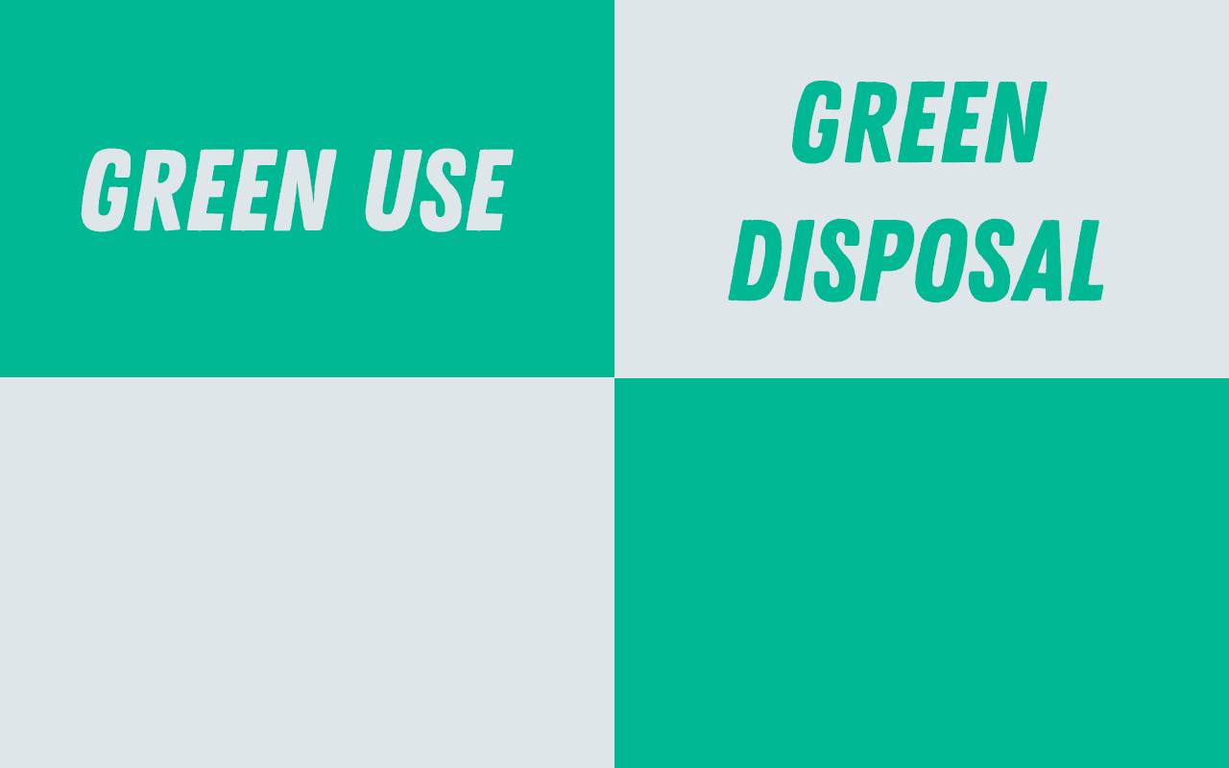
Roads to Green Computing?
Repurposing existing equipment or appropriately disposing of, or recycling, unwanted electronic equipment
Ex: Recyclable materials are used for the laptop’s materials

Slide 9
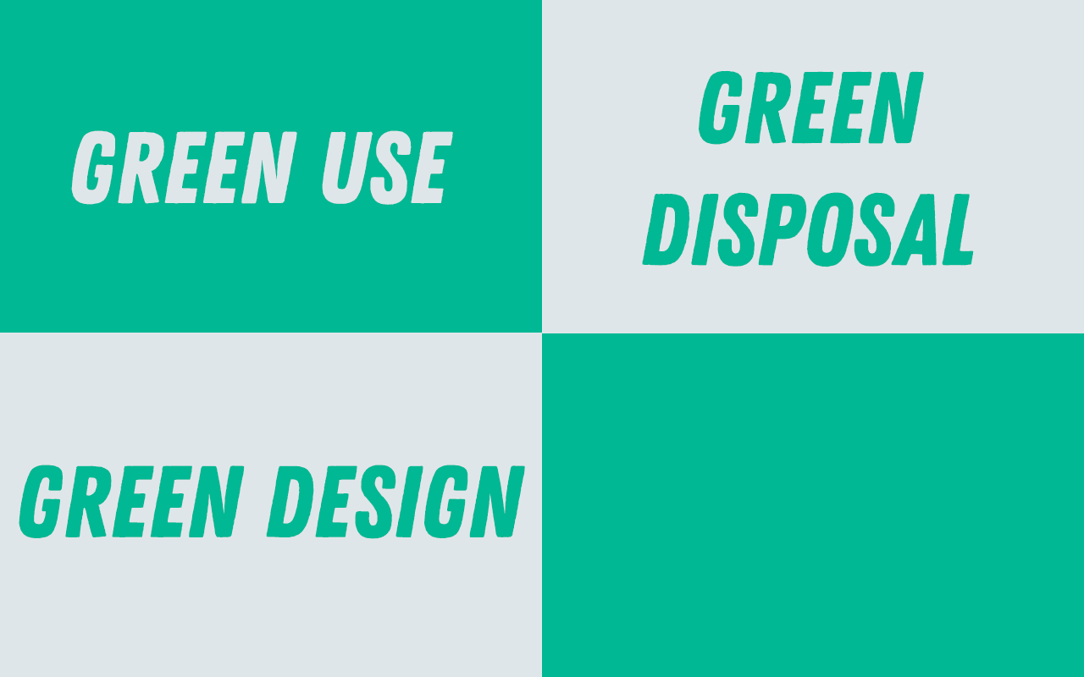
Roads to Green Computing?
Designing energy-efficient computers, servers, printers, projectors and other digital devices
Ex: Use of non toxic material, inside and outside of the computing device.

Slide 10
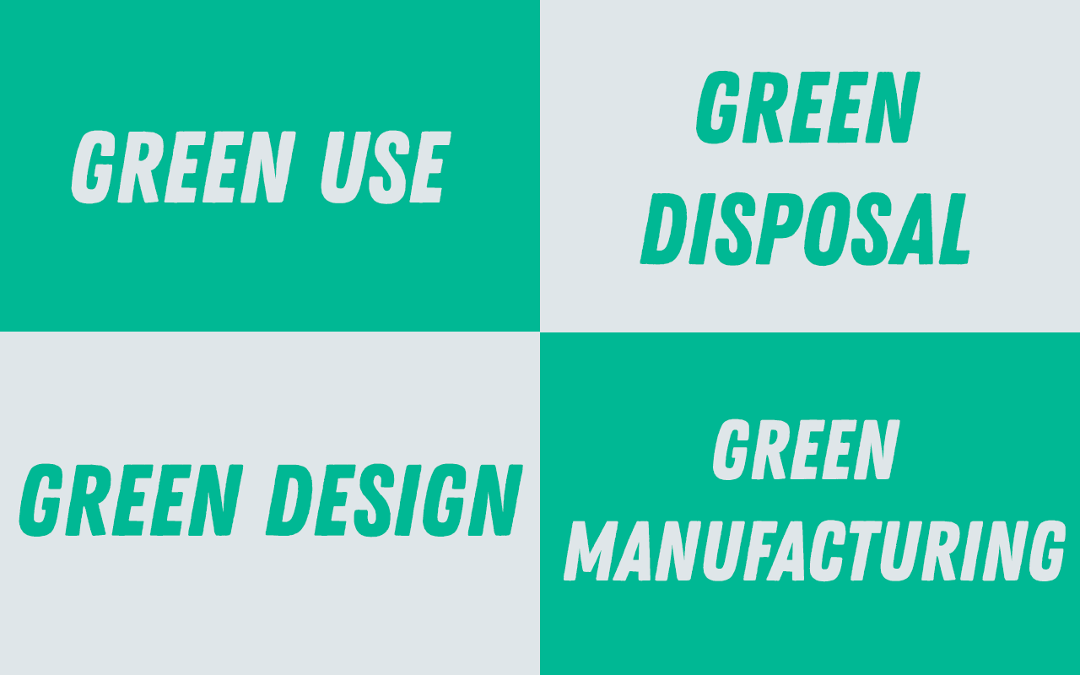
Roads to Green Computing?
Minimizing waste during the manufacturing of computers and other subsystems to reduce the environmental impact of these activities
Ex: this means that the manufacturer should also practice eco friendly manufacturing methods. Manufacturer’s cannot created eco friendly products in non-eco friendly factories.

Slide 11
How be “green” while computing
Look for electronic devices with the “energy star” label. Those devices only waste a maximum of 20% of energy.
Reduce the brightness of the monitor. This wastes less energy
Go to the control panel and turn your device on the “power save” mode.
Print double sided pages and print less. This wastes less paper. Buy recycled printer paper as often as you can.
Recycle your printer cartridges
Recycle your old laptops and desktop computers, don’t throw them away!
https://jpius-aloneep9.weebly.com/statistics-and-being-green.html

Slide 12
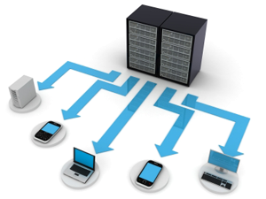





Approaches to Green Computing
Virtualization – process of running two or more logical computer systems on one set of physical hardware.
2. Power Management – ACPI allows an OS to directly control power saving aspects of its underlying hardware.
3. Power Supply – Climate servers computing initiative promotes energy saving and reduction of green house gas emissions by encouraging development and use of more efficient power supplies
Display – LCD monitors typically use cold-cathode fluorescent bulb to provide light for the display.
5. Storage – There are 3 routes available, all of which vary in cost, performance and capacity Material Recycling
6. Telecommuting – Telecommuting technologies implemented in green computing initiatives have advantages like increased worker satisfaction, reduction of greenhouse gas emissions related to travel and increased profit margins
Notes:
Advanced Configuration and Power Interface

Slide 13
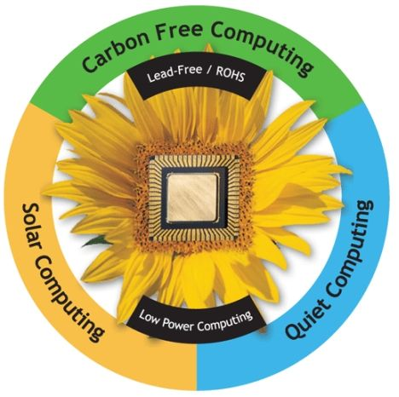


Methods of Implementing Green Computing
Carbon Free Computing
Solar Computing
Lead-free And RoHS Computing
Energy Efficient Computing

Slide 14




Role Of IT Vendors
Apple
Wipro
Google

Slide 15

Energy Use of PCs
CPU uses 120 Watts
CRT uses 150 Watts
8 hours of usage, 5 days a week = 562 Kwatts
for a large institution, say a university of 40,000 students and faculty, the power bill for just computers can come to $2 million / year
Energy use comes from
electrical current to run the CPU, motherboard, memory
running the fan and spinning the disk(s)
monitor (CRTs consume more power than any other computer component)

Slide 16



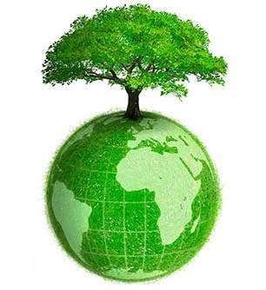


Green Web Surfing
Greener Google Browsing:Blackle.com
Being Green with Yahoo!
Greener FireFox Surfing
Other Green Surfing Efforts

Slide 17
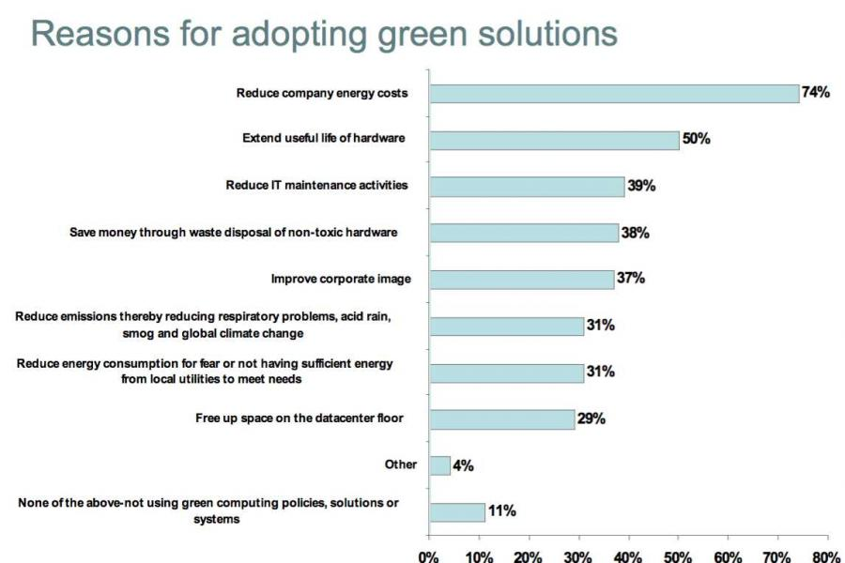

Slide 18
Steps For Green Computing
Environmentally Sound Purchase Systems
Sustainable Green Computing Plan
Reduce Paper Consumption
Conserve Energy
Recycling
Advantages
Reduce Energy Usage
Conserving Resources
Reduces The Risk
Saving The Energy
Saving The Planet

Slide 19
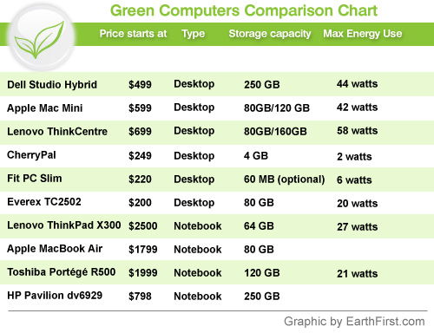
https://www.slideshare.net/subtlejaya/green-computing-12673497

Slide 20
Recent Implementations
Blackle
Fit-PC
Zonbu computer
Sunray thin client
The Asus Eee PC
Other implementations

Slide 21
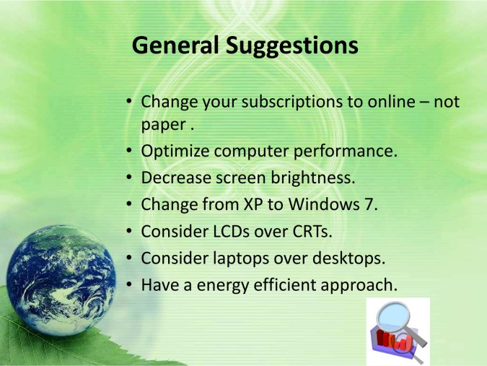

Slide 22

Future Of Green Computing
The plan towards green IT should include new
electronic products and services with optimum
efficiency and all possible options towards
energy savings.

Slide 23

Conclusion
The greenest computer will not miraculously
fall from the sky one day, it’ll be the product of
years of improvements. The features of a green
computer of tomorrow would be like: efficiency,
manufacturing & materials, recyclability,
service model, self-powering, and other trends.

Slide 24
